Slide 2
Fixed mislabeled GND pin on Raspberry Pi Header (Pin 38)

Slide 3
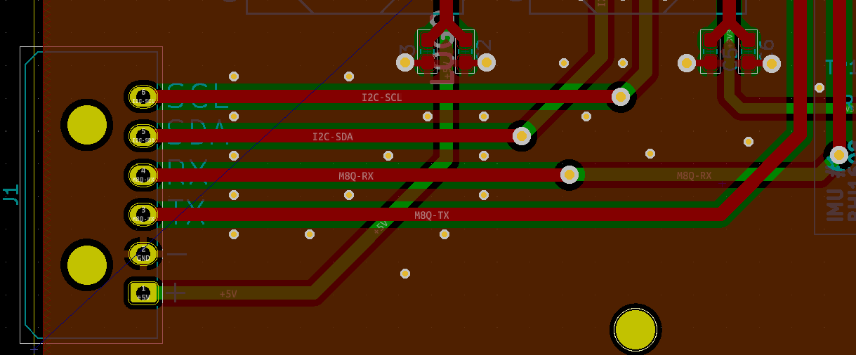
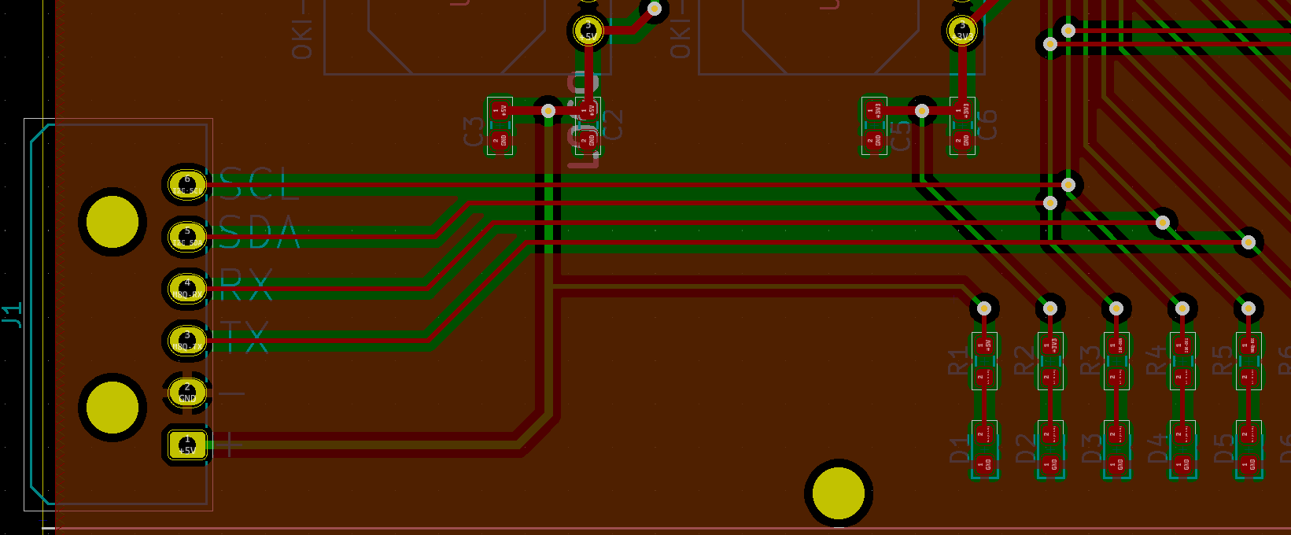
GPS I2C & SPI Lines
Thicker Traces, Lower Resistance
Greater Spacing
Ground Plane Shielding
Added Vias To Reduce Ground Impedance, Improved Shielding

Slide 4
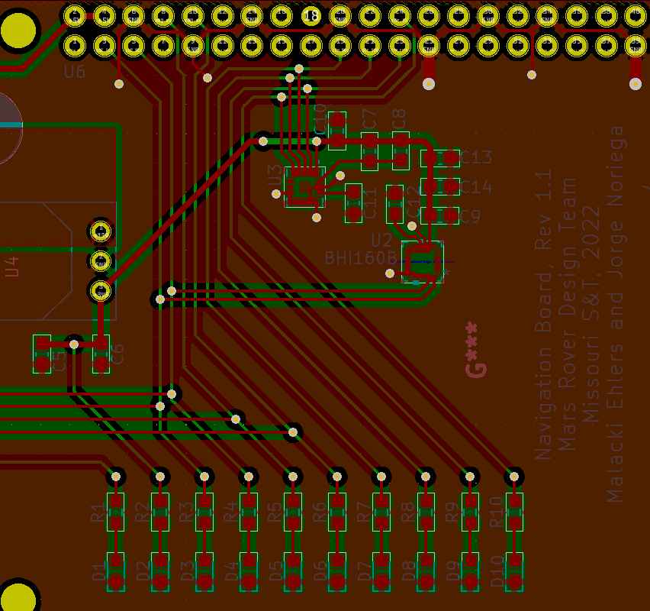
Old Accelerometer Layouts
Decoupling Capacitors
Far from the chips
Located along common power line, reducing effectiveness
Unused pins are left floating
SPI lines and I2C lines
Cross over each other
Unnecessarily small and long
LEDs are powered directly off data lines, reducing signal integrity and power

Slide 5
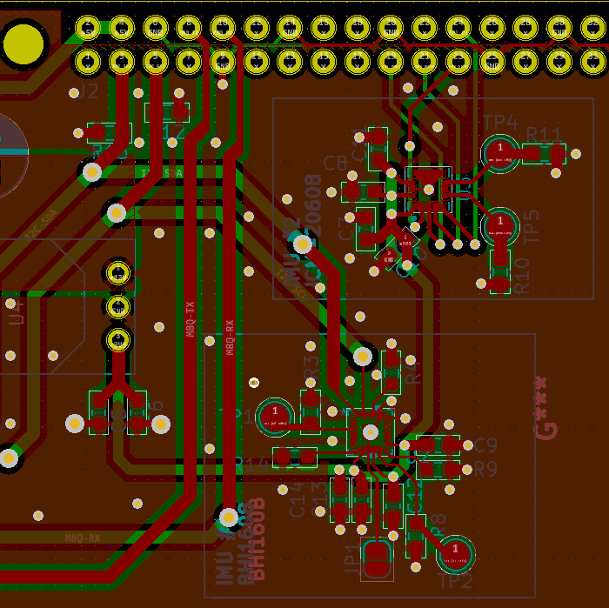
New Accelerometer Layout
Decoupling Capacitors
Closer to power pins
Individual 3V3 connections
Unused Pins Connected To Pulldown Resistors, Optional Pins Have Test Points
SPI and I2C lines
Do Not Cross, Not Even Nearby
Thicker Traces
Isolated With Ground Plane In Between
Added Vias To Add Shielding Inside Substrate
LEDs moved off data lines, connected directly to Raspberry Pi

Slide 6
New Accelerometer Layouts

